Slide 1
Business Intelligence using Product Star Rating & Customer’s Reviews
Implementation of Recommender Systems and Natural Language Processing on Amazon Dataset
Group Members:
Bhuvan Chopra, Junaid Qazi, & Fatemeh Rostamzadeh Renani

Slide 2
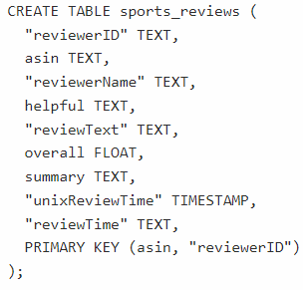
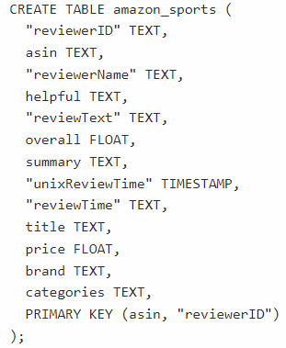
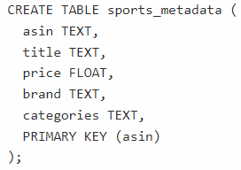
Data Loading in Cassandra
REVIEWS DATA JSON 1
reviewerID: ID of the reviewer - Unique
asin: ID of the product - Also unique
reviewerName: Name of the reviewer
helpful: Helpfulness rating of the review
reviewText: Text of the review
overall: Rating of the product
summary: Summary of the review
unixReviewTime: Time of the review - Unix time
reviewTime: Time of the review - Raw
TABLE 1
(3268695 records)
TABLE 3
(2730641 records)
Data of product ratings and reviews from Amazon.
Extracted data related to category “Sports and Outdoors” from 2 JSON files.
JOINED
ON
‘ASIN’
TABLE 2
(452030 records)
METADATA JSON 2
asin: ID of the product
title: Name of the product
price: Price in USD
brand: Brand name
categories: List of categories the product belongs

Slide 3
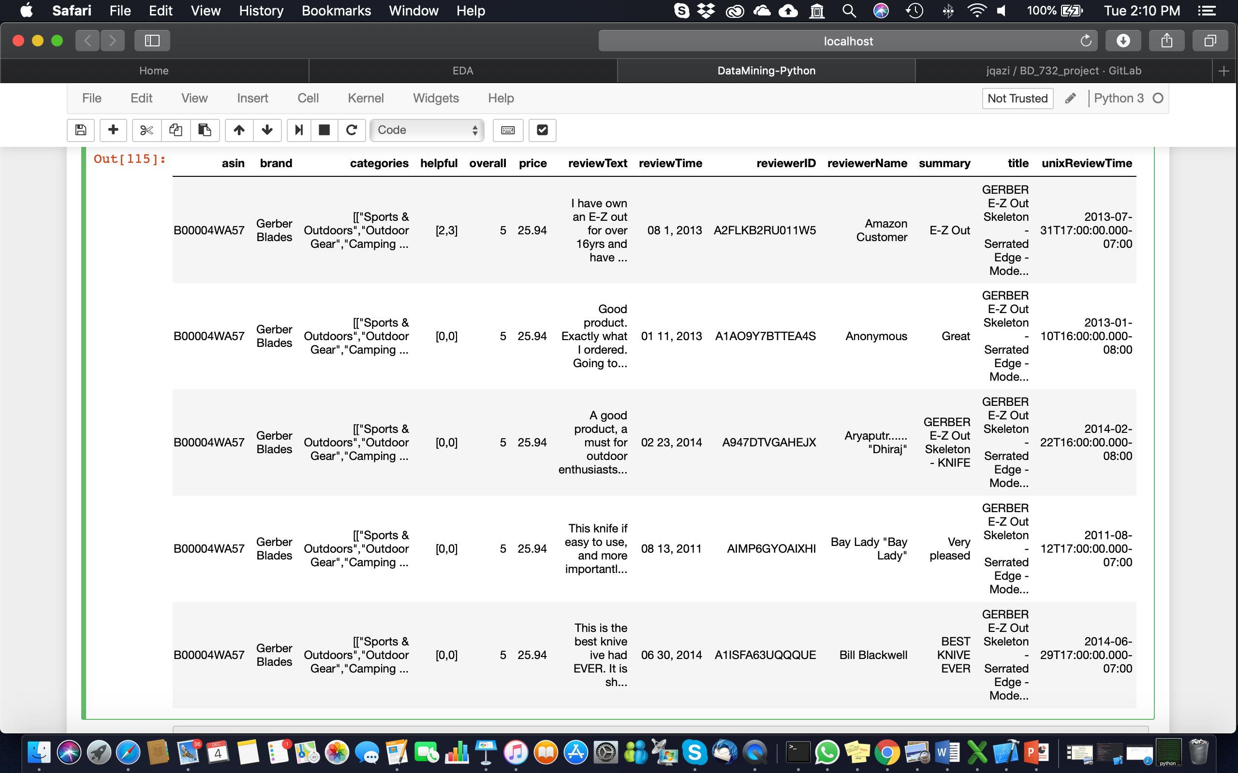
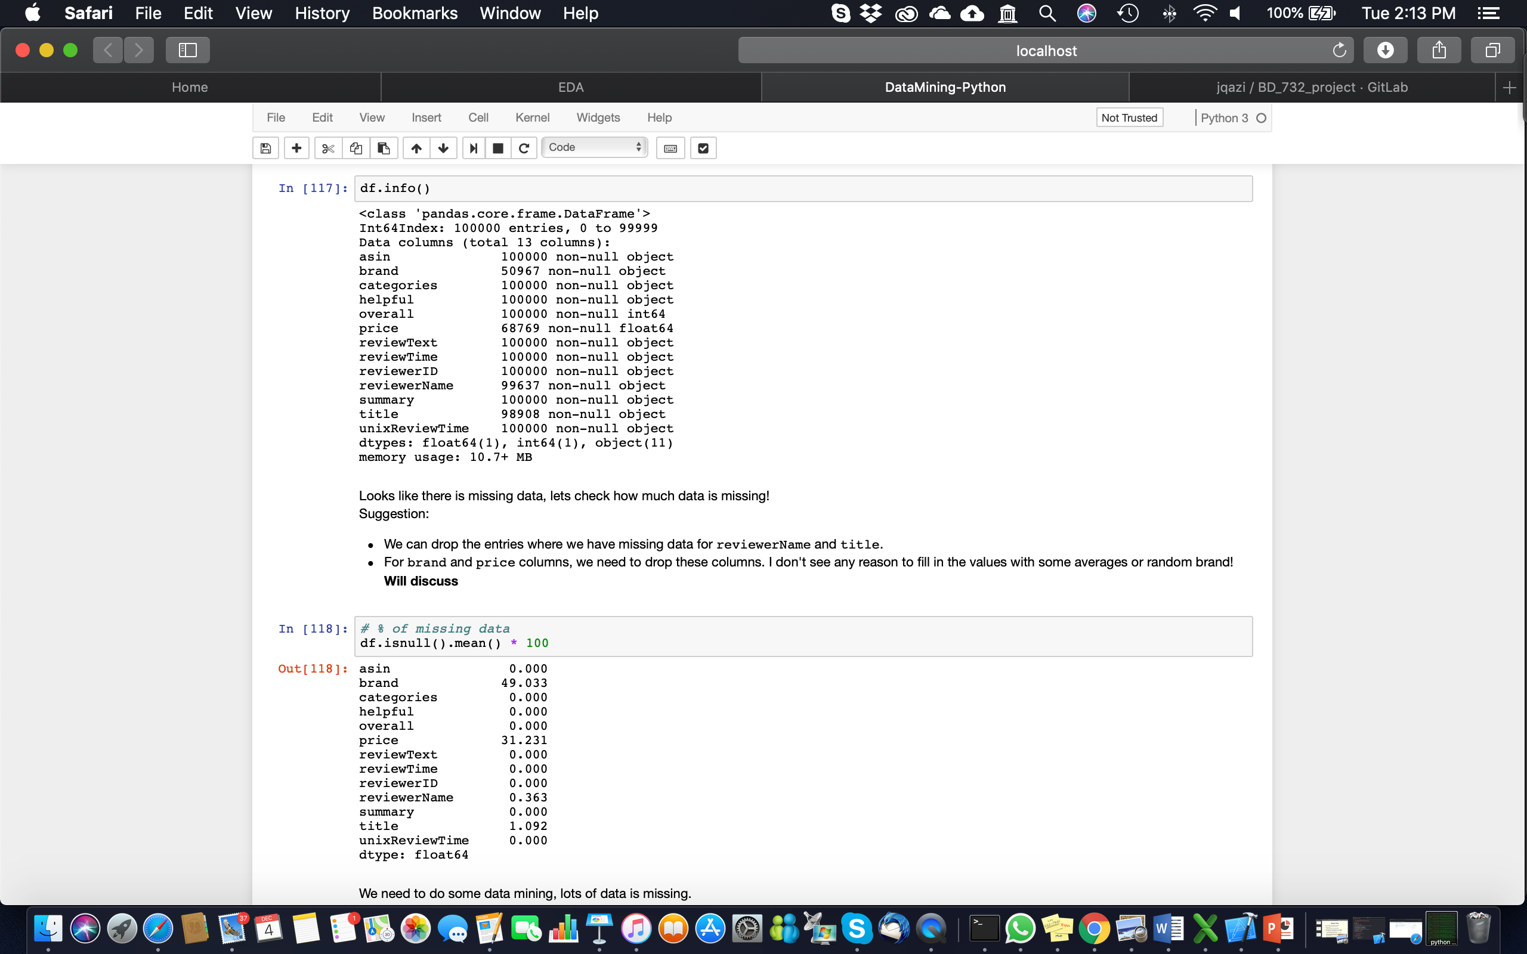
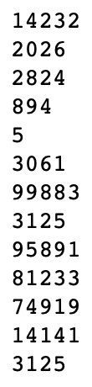
Data Analysis, Cleaning, Visualization
Created a smaller sample dataset in “data.json” for data cleaning and analysis:
Selected Columns:
asin, brand, categories, helpful, overall, price, reviewText, reviewTime, reviewerID, reviewerName, summary, title, unixReviewTime
Columns
missing data %
unique values
Data Cleaning:
Dropped columns brand, price
Dropped rows with missing reviewerName and title
Changed column name overall to rating
Re-created a column for help 1/0 – if [0,0] then 0 else 1
Created a column for get the length of each reviewer.
Created columns with integer codes for asin & reviewerID using .astype('category').cat.codes
Saved the file to “data_clean.csv” for further analysis and visualization

Slide 4
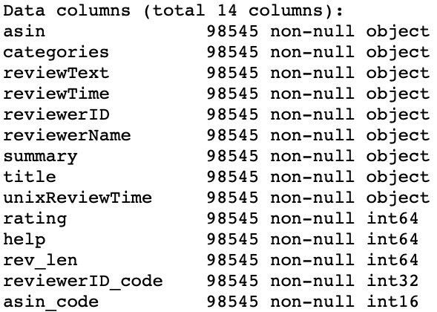
Data Analysis, Cleaning, Visualization
After Cleaning, feature engineering etc
More higher star ratings suggest that overall, customers are happy with the quality of the products in Amazon’s “sports & outdoor” section.
Blue arrows points to the new columns

Slide 5
Data Analysis, Cleaning, Visualization
Happy customers don’t usually put longer reviews!
Products with higher average rating got higher sale

Slide 6
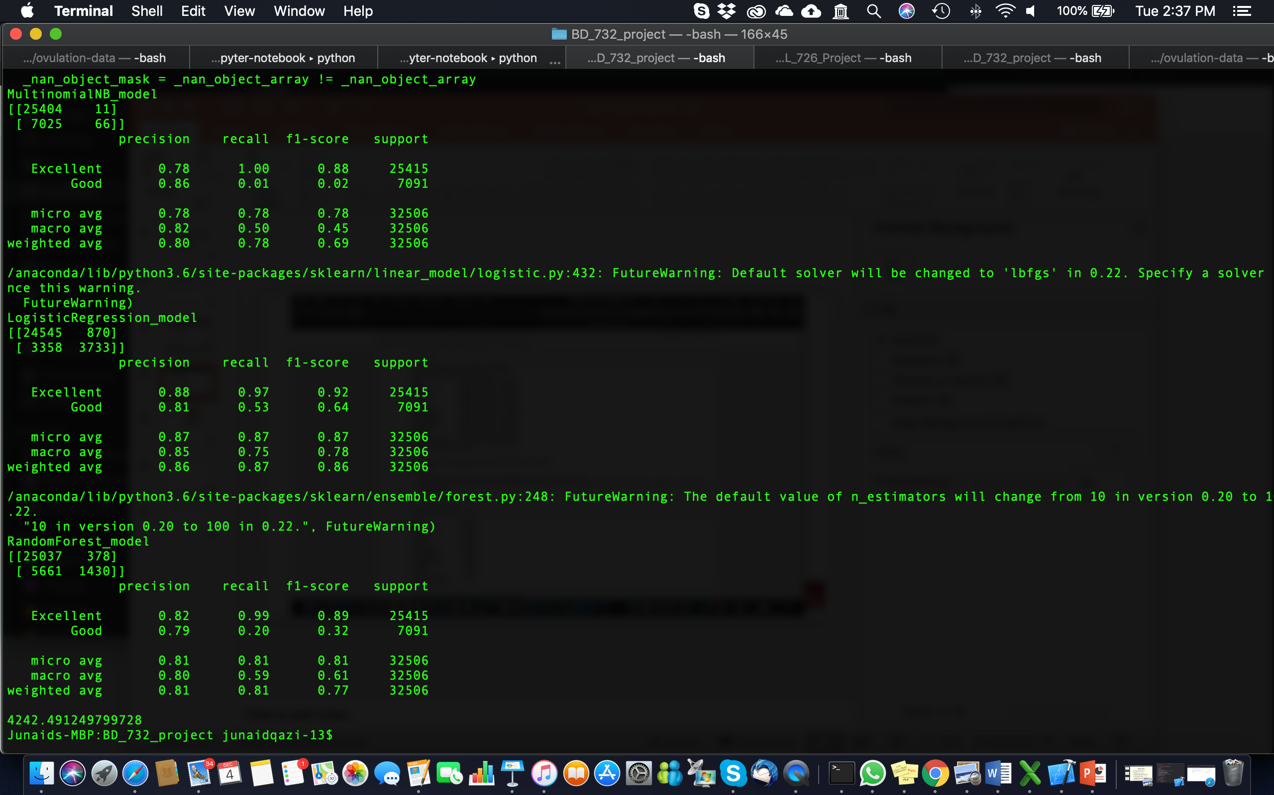
Natural Language Processing using NLTK
Text pre-processing:
Dealing with NaN in reviews
Splitting rating into two classes:
(1 to 3 = good )
(4 & 5 = excellent )
Tokenization:
Removing punctuations
Removing stopwords
Bag of Word
Vectorization:
TF – IDF
Normalization
Created pipeline to test three models:
Multinomial Naive Bayes
Logistic Regression
Random Forests
Model training and evaluation
Model Results:

Slide 7
Recommender System Collaborative Filtering
Alternating Least Squares (ALS) in Spark
ALS (rank, maxlter, regParam, numUserBlocks, numItemBlocks, alpha,seed, userCol, itemCol, ratingCol, nonnegative, coldStartStrategy, implicitPrefs, checkpointInterval, intermediateStorageLevel, finalStorageLevel)
rank: the number of latent factors in the model (defaults to 10).
maxIter: maximum number of iterations to run (defaults to 10).
regParam: specifies the regularization parameter in ALS (defaults to 1.0).
numBlocks: number of blocks the users and items will be partitioned into for parallelize (defaults to 10).
implicitPrefs: whether to use the explicit or implicit feedback ALS variant (defaults: false to use explicit).
alpha: parameter applicable to the implicit feedback variant of ALS (defaults to 1.0).
nonnegative: specifies whether or not to use nonnegative constraints for least squares (defaults to false).

Slide 8
Recommender System Collaborative Filtering
Alternating Least Squares (ALS) in Spark
It requires integers for costumer and product: StringIndexer can be used
Small costumed dataset was used to optimize rank, maxlter, regParam parameters
nonnegative= True (default is False) improved the model
RMSE (validation) = 4.629381 for the model trained with rank = 5, lambda = 0.010, and maxIter = 10.
RMSE (validation) = 3.817188 for the model trained with rank = 5, lambda = 0.010, and maxIter = 20.
RMSE (validation) = 3.394493 for the model trained with rank = 5, lambda = 0.010, and maxIter = 30.
RMSE (validation) = 3.800132 for the model trained with rank = 5, lambda = 0.020, and maxIter = 10.
RMSE (validation) = 3.149453 for the model trained with rank = 5, lambda = 0.020, and maxIter = 20.
RMSE (validation) = 2.857772 for the model trained with rank = 5, lambda = 0.020, and maxIter = 30.
RMSE (validation) = 3.152878 for the model trained with rank = 5, lambda = 0.040, and maxIter = 10.
RMSE (validation) = 2.691502 for the model trained with rank = 5, lambda = 0.040, and maxIter = 20.
RMSE (validation) = 2.497991 for the model trained with rank = 5, lambda = 0.040, and maxIter = 30.
.
.
.
the best RMSE (validation) = 2.497991 for the model trained with rank = 5, lambda = 0.04, and maxIter = 30.

Slide 9
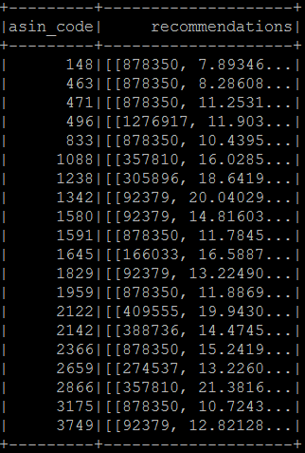
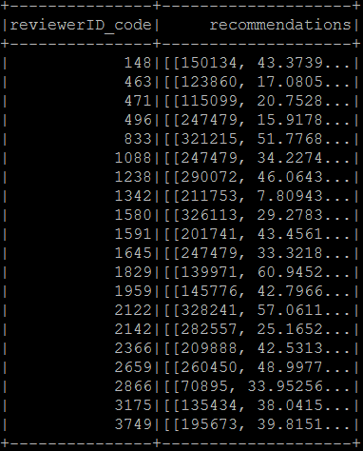
ALS Model Performance on 2.7M Entries
Output of model trained using the best hyper-parameters.
User Recommendations
for each product
Product Recommendations
for each user

Slide 10
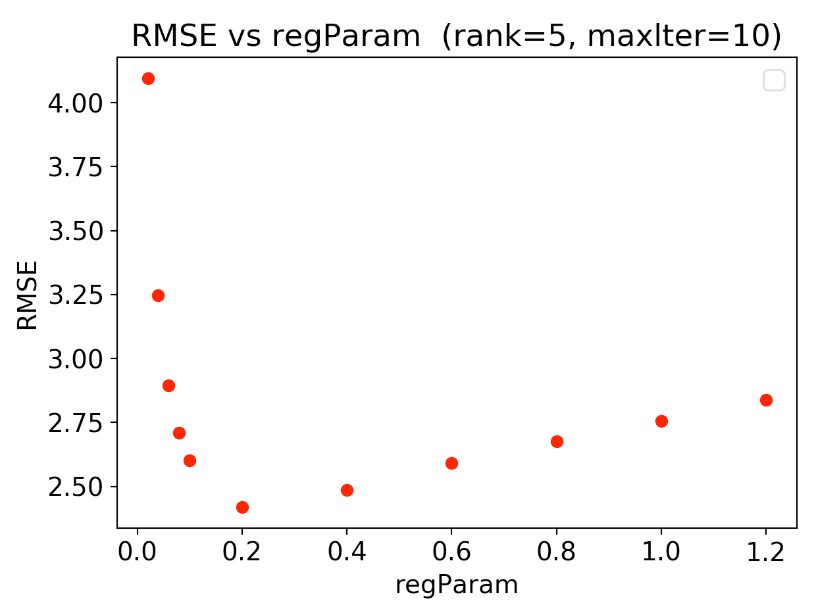
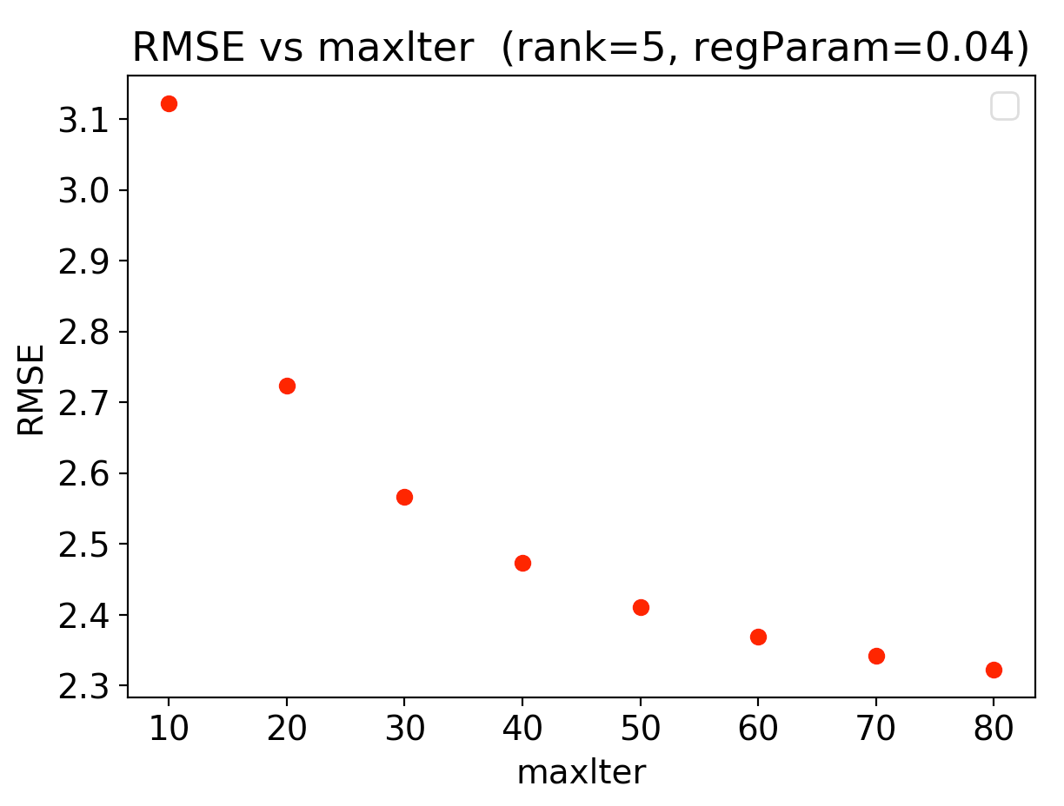
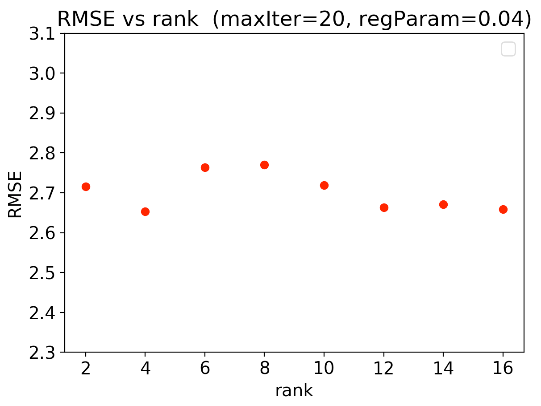
Recommender System Collaborative Filtering
Alternating Least Squares (ALS) in Spark
Although increasing the maxlter (number of iteration) improved the accuracy however for the full dataset spark fails to perform the calculation thus we set this parameter to its default value (10).
regularization parameter
maximum number of iterations
number of latent factors

Slide 11
Recommender System Collaborative Filtering
Surprise in Python
Advantage:
many prediction algorithms
better accuracy
Optimization:
n_ephocs : The number of iteration of the SGD procedure. Default is 20.
lr_all : The learning rate for all parameters. Default is 0.007.
reg_all : The regularization term for all parameters. Default is 0.02.
algorithm | RMSE
SVD++ | 1.1931
SVD | 1.1950
BaselineOnly | 1.1996
KNNBaseline | 1.1995
KNNBasic | 1.2551
KNNWithMeans | 1.2562
NMF | 1.2733
n_epochs: [10, 15, 20], lr_all: [0.003, 0.007, 0.009], reg_all: [0.02, 0.04, 0.06]}
<class 'surprise.prediction_algorithms.matrix_factorization.SVDpp'>
{'n_epochs': 15, 'lr_all': 0.009, 'reg_all': 0.06}
RMSE: 0.9018
A2AZGK5JIF862G ['B001M0NV9O']
A13L45CSY7TEQZ ['B00074H714']
A3P21LTE9FPQHI ['B001AQTLJE', 'B00CI7HNJO']
AAVJ1QH3N4E86 ['B0057XA2KS']
A2VX1KP8I6IFD3 ['B00BN2AUVS']
AZPPXT9KA8117 ['B006EE695Q']
A29HMA1ATAK4MB ['B009T0FYYO', 'B001NXD02I']

Slide 12
Performance on 2.7M Entries
Surprise in Python vs. Spark
The collaborative filtering for recommender system is faster using Spark however the accuracy is lower in Spark in comparison to Surprise Library.
Python using Surprise Library
ML library in Spark
RMSE: 0.8793
real 35m53.155s
user 34m56.284s
sys 0m38.752s
RMSE = 1.651045
real 7m43.240s
user 4m21.168s
sys 0m14.576s
more model choices
more time consuming
more accurate
one model (ALS)
less time consuming
less accurate

Slide 13
Outcomes & suggestions
Sellers consistently maintain the quality of the products to give better choice to the customers with healthy competition.
Customers are overall happy with the quality of the products.
Produces with higher mean rating has higher probability of sale.
The review length is found the be correlated with the start ratings and the products with higher rating were observed to have shorter reviews.
NLP provides an excellent tool to facilitate the customers to find quality products, star rating can be predicting using simple models from customer reviews.
Commonly available machine learning models perform good on text reviews with minimum pre-processing and their performance can be improved with techniques such as stemming.
Recommender systems are one of the most successful and widespread application of machine learning technologies in business helping to increase the sale.
The collaborative filtering for recommender system is faster using Spark however the accuracy is lower in Spark in comparison to Surprise Library.

